Slide 1
Admin
Notes:
We have this week and Thursday next week. Then, we move on to another test. I will only be available on Tuesday during test week.
This weekend, thanks to the break, I’ll be solidifying the points and getting everything in order so y’all can know where you all stand.

Slide 2
Week 8
Ho’s, Ha’s, and Multiple T’s
Notes:
So last week we moved from estimating single points and concentrating only on central tendency and moved on to the idea that we have to be pretty wide with our approach to understanding the relationship between a sample and a population.
Now, we move on to discussing the game itself and how it works, different strategies, and different outcomes.

Slide 3
Hypotheses!
Notes:
So at this point, we've essentially fiddled with every piece of information you could imagine. Raw scores, we've looked at means, medians, modes, and done what amounts to some exploratory analysis. We've basically been playing some catch or kicking the ball back and forth.
It's time now to learn the sport we're going to play and the sport is called hypothesis testing. Now, there are other sorts of things we do in statistics (namely experiments) but we'll get to that later as they're essentially plays and strategies so that you can win (or lose) the game.
The two pieces we need to cocentrate on is:
The Null Hypothesis (often notated as H_{o})
The Alternate Hypothesis (often notated as H_{a})\
But what do these mean? Well, for the most part (as you should know by now and if you don't, pay special attention to the next few words), we make assumptions about a population parameter. That assumption is tentative, not absolute because we honestly can't know for sure, but in the midst and between the tentativeness and actually making that assertion officially (via a report or a paper or a report). Until it reaches that space though, we call it a hypothesis.
But hypotheses in statistics are a little different.

Slide 4
H_{o}
Notes:
The NULL.
H0: [x variable] has no relationship with [y variable] when [other x variables] are present in the model.
Ha: [x variable] has a significant relationship with [y variable] when [other x variables] are present in the model.
Note 1: When writing the hypothesis statement you need to replace the terms specified in the square parenthesis with the actual variable names. For instance in the case of Rent, square feet and number of bedrooms example the H0 and Ha for square feet will be stated as follows:
H0: Square feet has no relatoinship with Rent when number of bedrooms is present in the model
Ha: Square feet has a significant relationship with Rent when number of bedrooms is present in the model.
Similarly, you can have H0 and Ha for number of bedrooms:
H0: Number of bedrooms has no relationship with Rent when square feet is present in the model
Ha: Number of bedroms has a significant relationship with Rent when square feet is present in the model
Note 2: You need as many H0 / Ha statements as there are number of x varaibles in the model. For instance you have two x variables in the model, then you would need two sets of H0 and Ha, i.e. one set of Ho and Ha for each x variable.
Why it is important to say that last phrase “when other x variables are included in the model”?
To explain the answer for this question I will like to show you couple of examples.

Slide 5
H_{a}
Notes:
Alternative Hypothesis, Altenate Hypothesis, or the Research Hypothesis. In other courses, this will be called a research question or something like that.

Slide 6
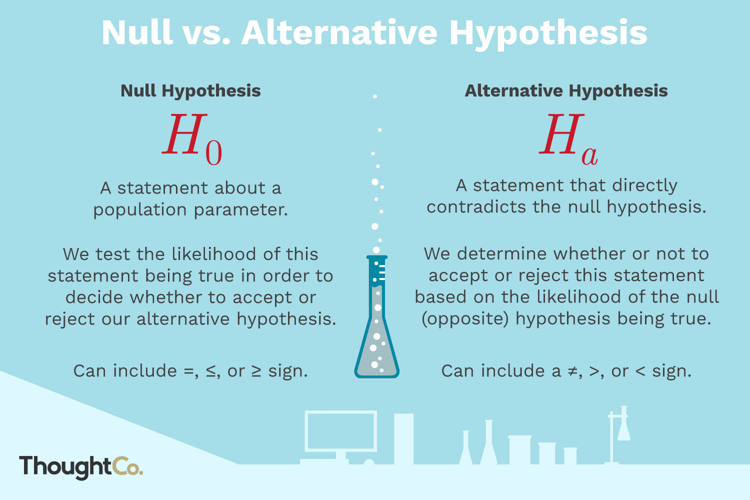
Notes:
Alternative Hypothesis, Altenate Hypothesis, or the Research Hypothesis. In other courses, this will be called a research question or something like that.

Slide 7
How we write it out
Notes:
We have this week and Thursday next week. Then, we move on to another test. I will only be available on Tuesday during test week.

Slide 8
H₀: μ ≤ 24 H_{a}: μ > 24
Notes:
We have this week and Thursday next week. Then, we move on to another test. I will only be available on Tuesday during test week.

Slide 9
So…what?
Notes:
We have this week and Thursday next week. Then, we move on to another test. I will only be available on Tuesday during test week.

Slide 10
This is Stupid

Slide 11
Don’t worry, it gets worse better

Slide 12
Error

Slide 13
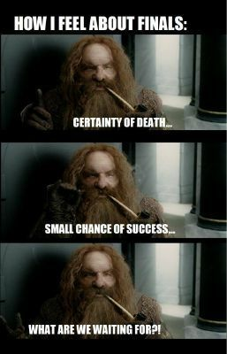

Slide 14
Type 1 Errors
Notes:
We have this week and Thursday next week. Then, we move on to another test. I will only be available on Tuesday during test week.

Slide 15
Type 2 Errors
Notes:
We have this week and Thursday next week. Then, we move on to another test. I will only be available on Tuesday during test week.

Slide 16
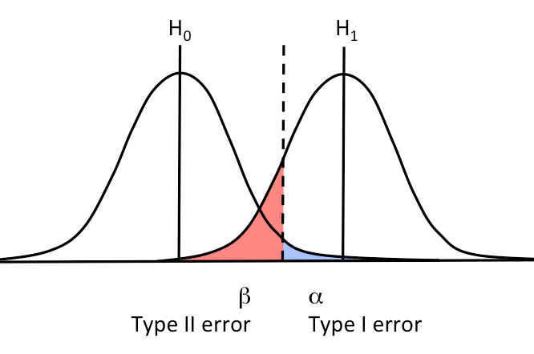
Notes:
We have this week and Thursday next week. Then, we move on to another test. I will only be available on Tuesday during test week.

